Slide 1
Precinct Signage
run at 12:26PM on October 12, 2018

Slide 2
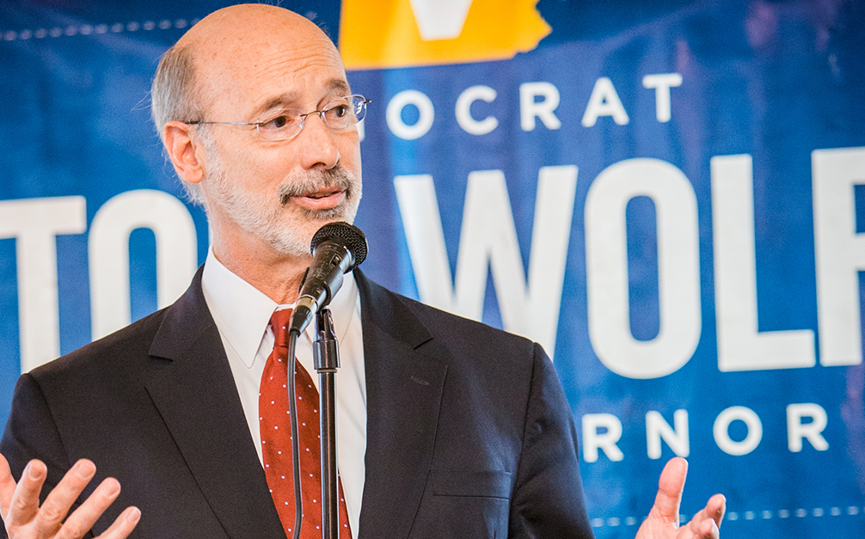





HorshamDems.Org
2018 Mid-Term Election
HORSHAM 1-1
Pennsylvania Governor
Pennsylvania Lt. Governor
PA House 151st
PA Senate 12th
U.S. Senate
PA 4th Congressional

Slide 3
HorshamDems.Org
2018 Mid-Term Election
HORSHAM 1-2
Pennsylvania Governor
Pennsylvania Lt. Governor
PA House 151st
PA Senate 12th
U.S. Senate
PA 4th Congressional

Slide 4
HorshamDems.Org
2018 Mid-Term Election
HORSHAM 1-3
Pennsylvania Governor
Pennsylvania Lt. Governor
PA House 151st
PA Senate 12th
U.S. Senate
PA 4th Congressional

Slide 5
HorshamDems.Org
2018 Mid-Term Election
HORSHAM 1-4
Pennsylvania Governor
Pennsylvania Lt. Governor
PA House 151st
PA Senate 12th
U.S. Senate
PA 4th Congressional

Slide 6
HorshamDems.Org
2018 Mid-Term Election
HORSHAM 1-5
Pennsylvania Governor
Pennsylvania Lt. Governor
PA House 151st
PA Senate 12th
U.S. Senate
PA 4th Congressional

Slide 7

HorshamDems.Org
2018 Mid-Term Election
HORSHAM 2-1 (1st)
Pennsylvania Governor
Pennsylvania Lt. Governor
PA House 151st
PA Senate 12th
U.S. Senate
PA 1st Congressional

Slide 8
HorshamDems.Org
2018 Mid-Term Election
HORSHAM 2-1 (4th)
Pennsylvania Governor
Pennsylvania Lt. Governor
PA House 151st
PA Senate 12th
U.S. Senate
PA 4th Congressional

Slide 9
HorshamDems.Org
2018 Mid-Term Election
HORSHAM 2-2
Pennsylvania Governor
Pennsylvania Lt. Governor
PA House 151st
PA Senate 12th
U.S. Senate
PA 4th Congressional

Slide 10
HorshamDems.Org
2018 Mid-Term Election
HORSHAM 2-3
Pennsylvania Governor
Pennsylvania Lt. Governor
PA House 151st
PA Senate 12th
U.S. Senate
PA 1st Congressional

Slide 11
HorshamDems.Org
2018 Mid-Term Election
HORSHAM 2-4
Pennsylvania Governor
Pennsylvania Lt. Governor
PA House 151st
PA Senate 12th
U.S. Senate
PA 4th Congressional

Slide 12
HorshamDems.Org
2018 Mid-Term Election
HORSHAM 3-1
Pennsylvania Governor
Pennsylvania Lt. Governor
PA House 151st
PA Senate 12th
U.S. Senate
PA 4th Congressional

Slide 13
HorshamDems.Org
2018 Mid-Term Election
HORSHAM 3-2
Pennsylvania Governor
Pennsylvania Lt. Governor
PA House 151st
PA Senate 12th
U.S. Senate
PA 4th Congressional

Slide 14
HorshamDems.Org
2018 Mid-Term Election
HORSHAM 3-3
Pennsylvania Governor
Pennsylvania Lt. Governor
PA House 151st
PA Senate 12th
U.S. Senate
PA 4th Congressional

Slide 15
HorshamDems.Org
2018 Mid-Term Election
HORSHAM 3-4
Pennsylvania Governor
Pennsylvania Lt. Governor
PA House 151st
PA Senate 12th
U.S. Senate
PA 4th Congressional

Slide 16
HorshamDems.Org
2018 Mid-Term Election
HORSHAM 3-5
Pennsylvania Governor
Pennsylvania Lt. Governor
PA House 151st
PA Senate 12th
U.S. Senate
PA 4th Congressional

Slide 17
HorshamDems.Org
2018 Mid-Term Election
HORSHAM 4-1
Pennsylvania Governor
Pennsylvania Lt. Governor
PA House 151st
PA Senate 12th
U.S. Senate
PA 1st Congressional

Slide 18
HorshamDems.Org
2018 Mid-Term Election
HORSHAM 4-2 (1st)
Pennsylvania Governor
Pennsylvania Lt. Governor
PA House 151st
PA Senate 12th
U.S. Senate
PA 1st Congressional

Slide 19
HorshamDems.Org
2018 Mid-Term Election
HORSHAM 4-2 (4th)
Pennsylvania Governor
Pennsylvania Lt. Governor
PA House 151st
PA Senate 12th
U.S. Senate
PA 4th Congressional

Slide 20
HorshamDems.Org
2018 Mid-Term Election
HORSHAM 4-3
Pennsylvania Governor
Pennsylvania Lt. Governor
PA House 151st
PA Senate 12th
U.S. Senate
PA 1st Congressional

Slide 21
HorshamDems.Org
2018 Mid-Term Election
HORSHAM 4-4
Pennsylvania Governor
Pennsylvania Lt. Governor
PA House 151st
PA Senate 12th
U.S. Senate
PA 1st Congressional

